Slide 1
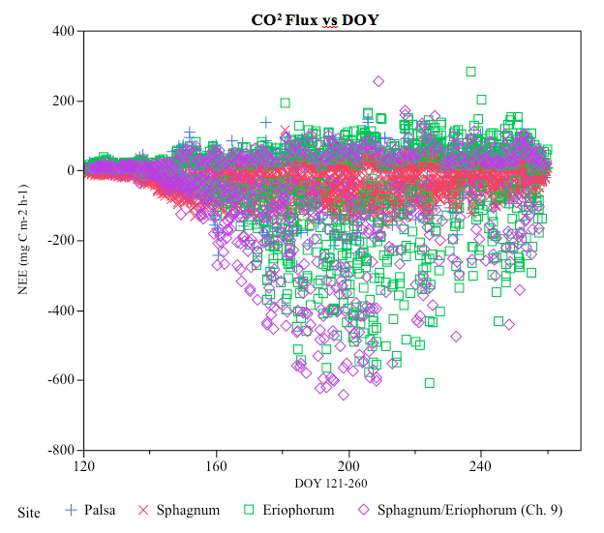
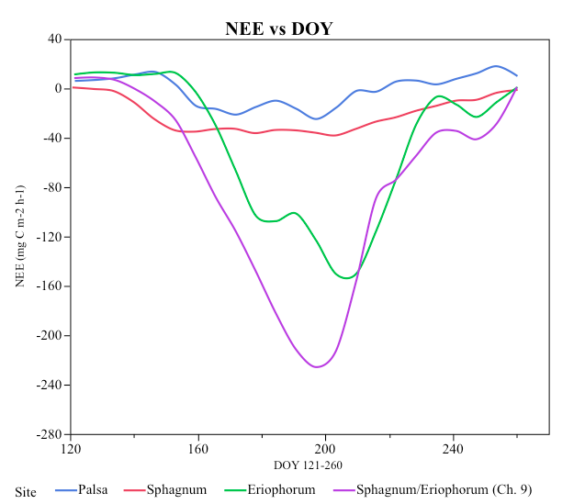
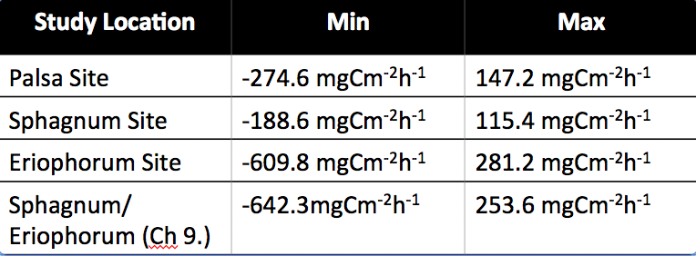
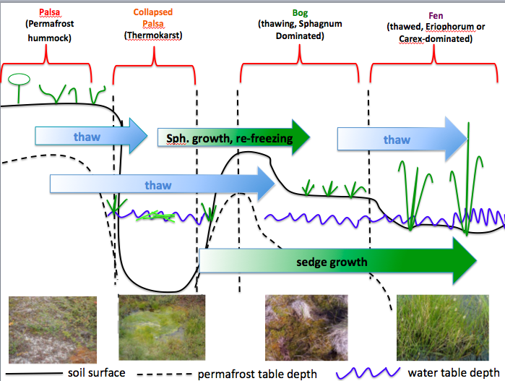
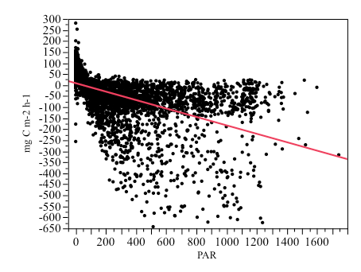
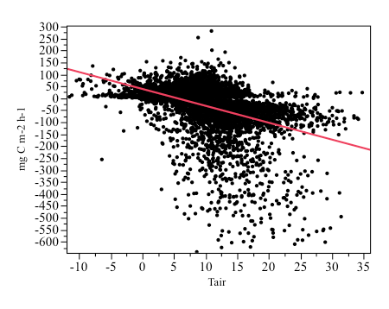
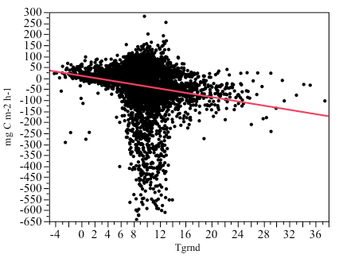
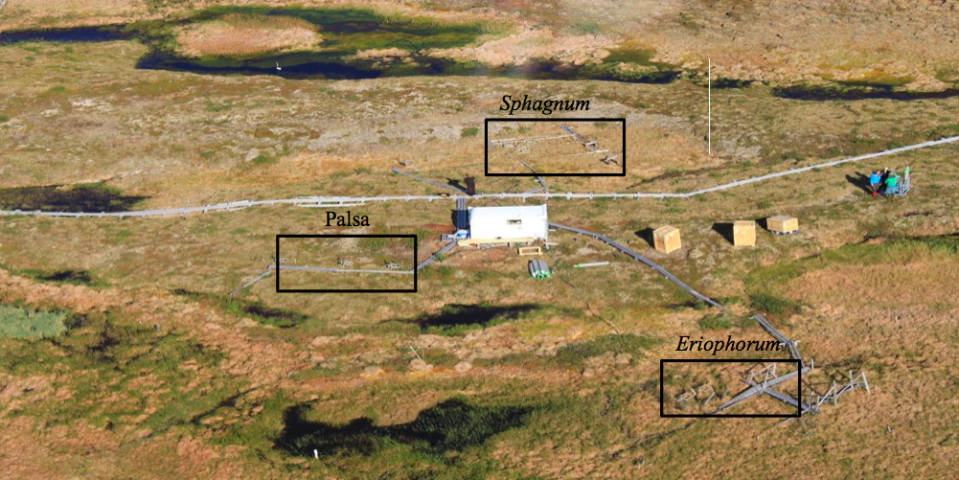
Automatic chamber measurements of Net Ecosystem (CO2) Exchange at a Subarctic Mire in Northern Sweden
Xavier Parker-Smith¹, Maeah Walthall², Ryan Lawrence³
¹North Carolina A&T State University North Carolina, USA. (xavierparkersmith@yahoo.com) ²George Mason University Virginia, USA. (mwalthal@gmu.edu) ³University of New Hampshire New Hampshire, USA(ryan.d.lawrence@gmail.com)
Introduction
Approximately 50% of the world’s soil carbon pool is contained in northern permafrost regions ^{[1]}
As of 2000, average temperature levels in the Swedish sub-arctic region has crossed the 0⁰C mean annual threshold for permafrost stability ^{[2]}
Peatlands in the Northern permafrost regions have been currently experiencing increased thaw rates, which can liberate carbon in the form of carbon dioxide (CO2) and total hydrocarbons (THCs) ^{[2,3]}
The addition of carbon dioxide and methane to the atmosphere will create positive feedback to global warming ^{[2, 4]}
Scientists question whether the northern peatlands will remain an overall carbon sink or if they will shift to a carbon source.
Results
Conclusion
Measurements were taken during the green season (days 121-260) of 2013
r²<0.87 to ensure 95% confidence level
PAR set to 0
Based on measurements made during peak growing season we were able to conclude that Stordalen mire during the summer of 2013 was a CO2 sink
All individual sites were atmospheric C sinks
PAR had the strongest environmental correlation to NEE
Research Field Site And Methodology
Table 2) Show the values of each vegetation site that represent the spatial variability flux. The minimum value represents C uptake and the maximum value represents C emissions. Base on the values within the table, the Eriophorum site and the Ch. 9 site have the highest C emission and C uptake data points.
Stordalen Mire near Abisko, Sweden (68°21' N, 19°03' E)
Primarily composed of three different ecosystems along a thaw gradient: Palsa, Sphagnum, and Eriophorum
Figure 3) Spatial Variability Flux Measurements by Site. The graph shows the individual data points for each site during the green season.
Figure 4) NEE vs day of year (DOY) of all 4 sites. This graph displays the trend of the NEE averages for each individual site throughout the green season. It gives a clearer insight to the atmospheric function of each site showing an average of C uptake.
Future Works
Incorporate active layer and water table data
Further examination of the correlation between environmental variables and NEE
Figure 1) Thaw Gradient
Table 1) A table showing the regression data of the environmental variables (PAR, Air Temperature, Ground Temperature) for each site. The values shown are r² values calculated for each site. The r² values explain how much a particular environmental variable impacts the data. Looking at the table, PAR as the highest r² value for each individual site showing that PAR explains most of the data.
Acknowledgements
Objective: To calculate the net ecosystem (CO2) exchange (NEE)
Automatic Chamber System was used to measure CO2 flux at each of the sites
Nine (9) chambers distributed among sites: n = 3 each in the palsa and Sphagnum habitats, and n = 2 in the Eriophorum habitat n=1 in the Eriophorum/Sphagnum site (Ch. 9)
Dr. Linda B. Hayden, Principal Investigator
Dr. Patrick M. Crill, Stockholm University, Sweden
Mr. Ryan Lawrence, Mentor
References
E. a G. Schuur, J. Bockheim, J. Canadell, E. Euskirchen, C. B. Field, S. V Goryachkin, S. Hagemann, P. Kuhry, P. Lafleur, H. Lee, G. Mazhitova, F. E. Nelson, a R. V., Romanovsky, N. Shiklomanov, C. Tarnocai, S. Venevsky, J. G. Vogel, and S. a Zimov, “Vulnerability of permafrost carbon to climate change: implications for the global carbon cycle,” Bioscience, vol. 58, no. 8, pp. 704–714, 2008
T. V. Callaghan, F. Bergholm, T. R. Christensen, C. Jonasson, U. Kokfelt, and M. Johansson, “A new climate era in the sub-Arctic: Accelerating climate changes and multiple impacts,” Geophys. Res. Lett., vol. 37, no. 14, pp. 1–6, 2010.
N. Malmer, T. Johansson, M. Olsrud, and T. R. Christensen, “Vegetation, climatic changes and net carbon sequestration in a North-Scandinavian subarctic mire over 30 years,” Glob. Chang. Biol., vol. 11, no. 11, pp. 1895–1909, 2005.
E. Applications and N. May, “Northern Peatlands : Role in the Carbon Cycle and Probable Responses to Climatic Warming Eville Gorham NORTHERN PEATLANDS : ROLE IN THE CARBON CYCLE AND PROBABLE RESPONSES TO CLIMATIC WARMING1,” vol. 1, no. 2, pp. 182–195, 1991.
.
Figure 6) Regressive NEE vs PAR
Figure 8) Regressive NEE vs Air Temperature
Figure 7) Regressive NEE vs Ground Temperature
Figure 2) Stordalen Mire Research Site

